Slide 1

Numeration systems
https://www.youtube.com/watch?v=cZH0YnFpjwU
Numeration systems are used to represent and manipulate numeric values.
We have to distinguish between a numeric value and a numeric representation:
a value (abstract concept) is a measure of an attribute of a collection of objects;
a representation is the means by which we display a value and manipulate it.
A value has different representations.
Example: the numeric value “5” has more representations:
5 (decimal system) , V (Roman system), 101( binary system)
cinci (Romanian language), five (English language)

Slide 2
Numeration systems (contd.)
At the mental level people work with values, but for displaying and manipulating them, different numeration systems are used (now the decimal system).
Computers work with number representations using the binary system.
Numeration system - a set of rules for the representation and manipulation (operations) of numerical values using symbols called digits.
The total number of digits is called numeration base(radix).
Classification of numeration systems:
positional systems and non-positional systems

Slide 3

Non-positional systems: Roman system (500BC)
digits: I , V , X , L , C , D , M
values: 1 5 10 50 100 500 1000
each symbol (digit) represents a value
it is an additive system:
- the value of a number representation is obtained as the
sum (difference) of the values of its digits according to some rules
Disadvantages:
the value 0 cannot be represented
there are different representations of the same value
example: CDXC and XD have the same value 490
the much greater difficulty of performing mathematical operations, such as addition, subtraction, multiplication, and division

Slide 4
Roman system - rules
the value of two or more identical consecutive digits is the sum of the values of these digits.
ex: numeric representations: III , CCC, MM
numeric values: 3 , 300, 2000
b) the value of a pair of different digits, with the biggest one in front of the other is the sum of these two digits values:
ex: numeric representations: VI , CL MD
numeric values: 5+1=6 , 100+50=150, 1000+500=1500
c) the value of a pair of different digits, with the smallest one in front of the other is the difference of these two digits values:
ex: numeric representations: XC , IX , CM
numeric values: 100-10=90, 10-1=9 , 1000-100=900
d) for big numbers a horizontal line over the digit is used, meaning the multiplication of the digit’s value with 1000:
ex: the numeric value of is 5000

Slide 5
Positional systems: Hindu-Arabic numeration systems
the position of a digit in a representation implies an association with a “positional value”
the numeric value is the sum of the positional values of all the digits from the representation
binary system: base = 2, digits : 0,1 , ex: 11001(2)
octal system: base = 8, digits: 0-7, ex: 7564(8)
decimal system(1800BC) base =10, digits: 0-9, ex: 2343
hexadecimal system: base =16, digits: 0-9,A,B,C,D,E,F
where: A(16)=10, B(16) =11, C(16)=12, D(16)=13, E(16)=14, F(16)=15, example: 2AF(16)

Slide 6
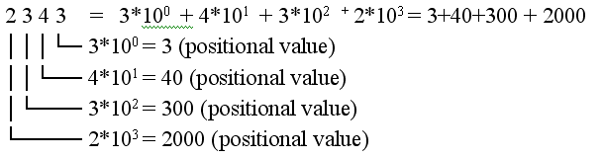
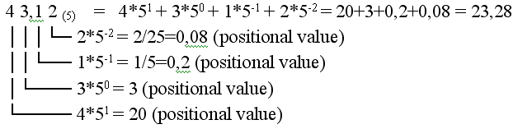
Examples

Slide 7
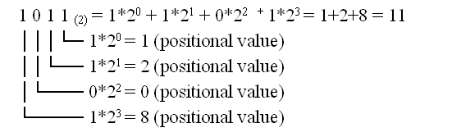
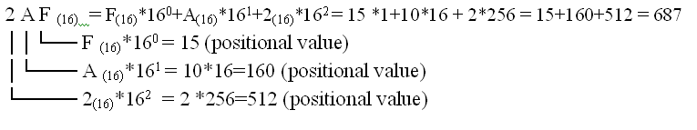
Examples

Slide 8
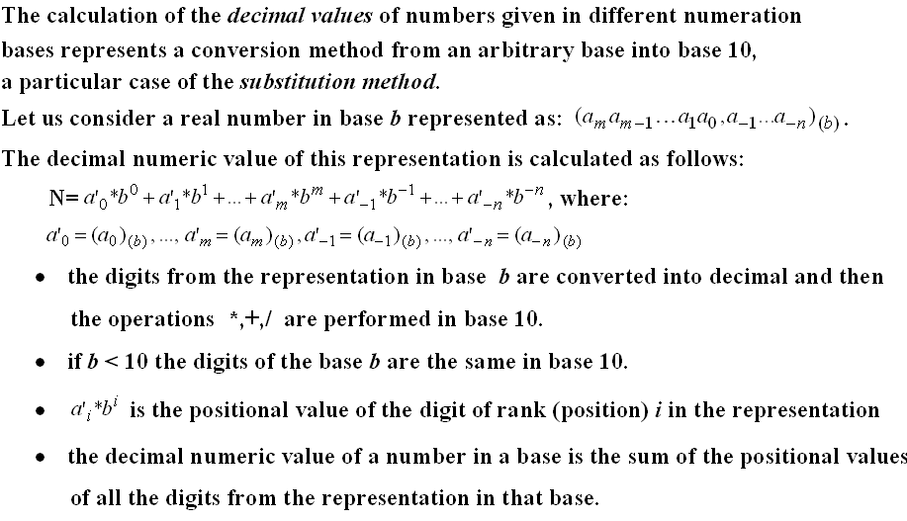

Slide 9
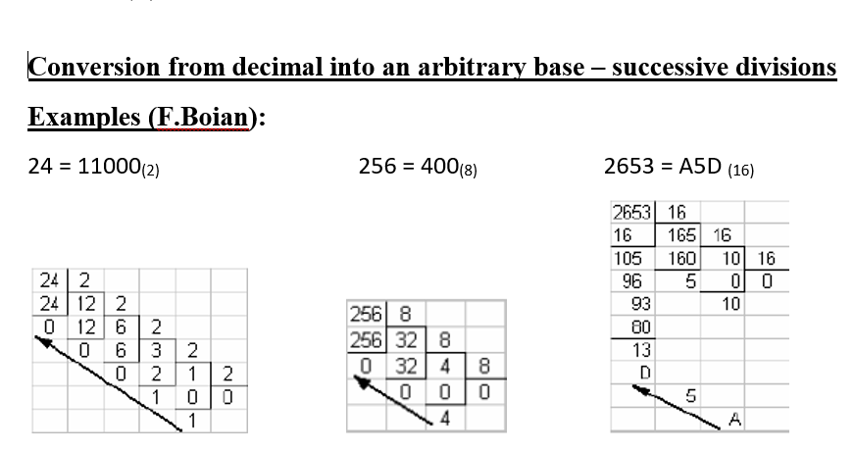

Slide 10
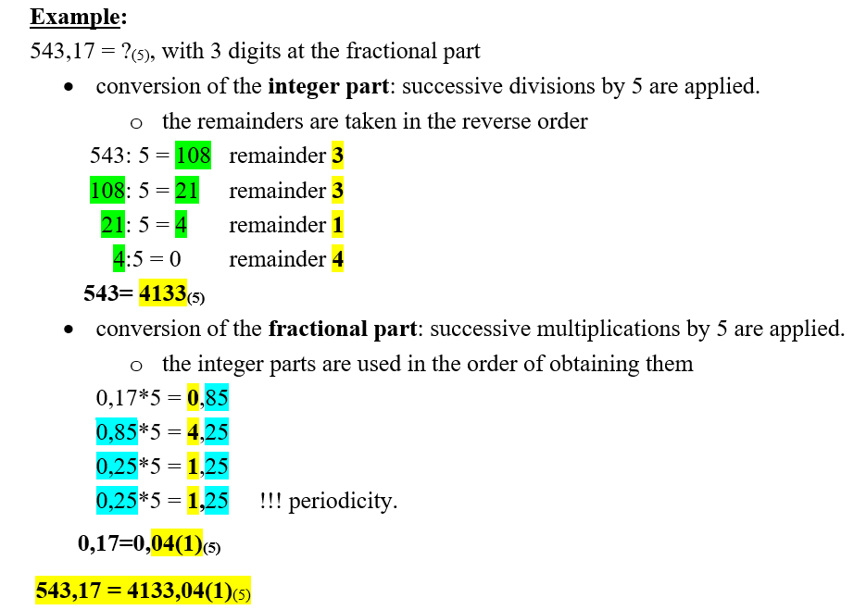

Slide 11
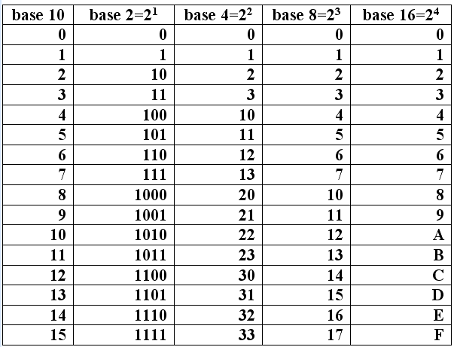
Correspondence table – bases: 10,2,4,8,16

Slide 12
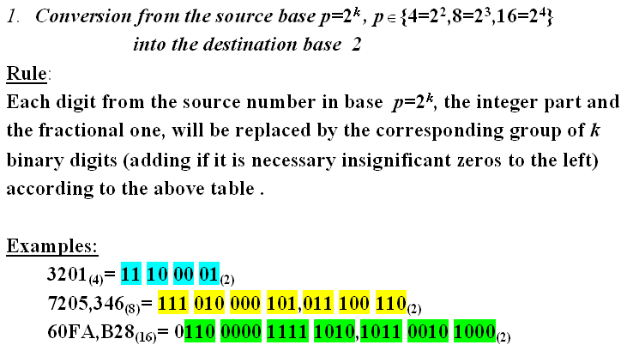
Rapid conversions: conversions between bases: 2,4,8,16

Slide 13
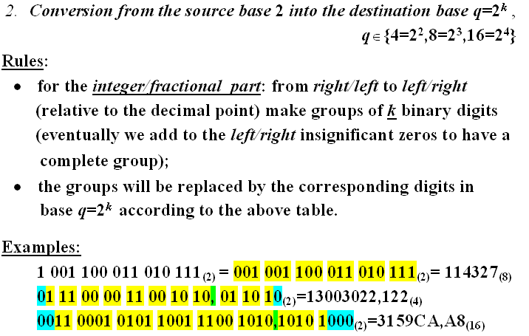
Rapid conversions (contd.)

Slide 14
Conversion methods
Conversions between arbitrary numeration bases for real
numbers:
N(b) = N’(h),
b- source base, h- destination base
1. the substitution method
2. the method of successive divisions/multiplications
3. the method that uses an intermediate base

Slide 15
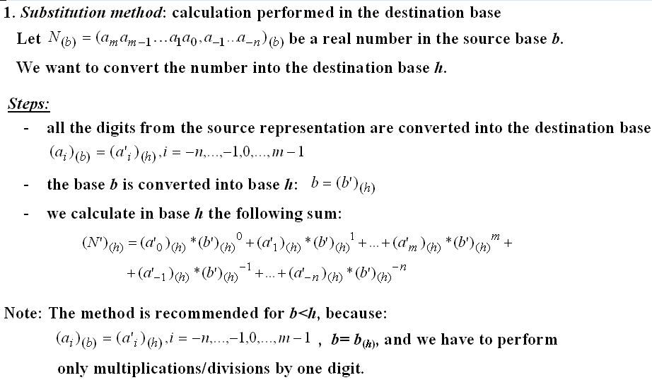

Slide 16
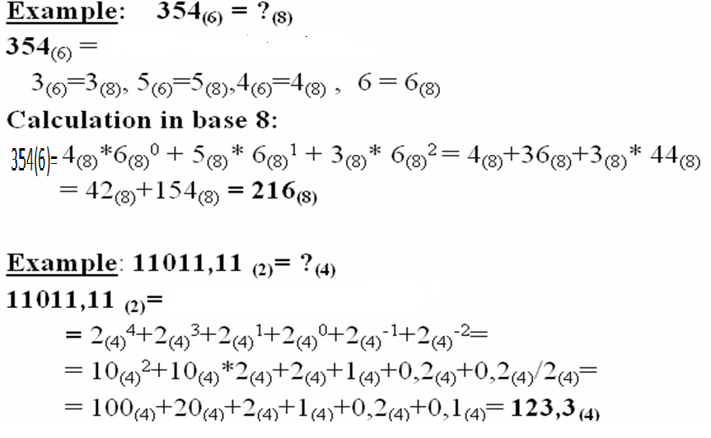
Substitution method - examples

Slide 17

2. The method of successive divisions and multiplications
it is recommended for b > h
calculations are performed in the source base (b)
for the integer part the method of successive divisions by the destination base (h) is applied
for the fractional part we apply a complementary method: successive multiplications by the destination base (h)

Slide 18
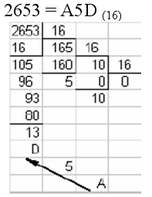
The method of successive divisions
the integer part is divided by h (destination base) obtaining a quotient and a remainder. the quotient is divided by h obtaining a new quotient an a new remainder,… the process of successive divisions ends when 0 is obtained as quotient. the remainders, in the reverse order of obtaining them, are the digits of the new representation in base h.

Slide 19
The method of successive multiplications
the fractional part is multiplied by h obtaining a number with an integer part and a fractional one; we continue with the multiplication of this new fractional part,... the process of the successive multiplications continues until one of the following conditions is satisfied: a) the fractional part becomes 0; b) an established number of digits of the fractional part were calculated c) periodicity is obtained. the integer parts, in the order of obtaining them are the digits of the fractional part in the destination representation. | Example: 0,17 =?(5) 0,17*5 = 0,85 0,85*5 = 4,25 0,25*5 = 1,25 0,25*5 = 1,25 !!! periodicity. 0,17=0,04(1)(5) ,

Slide 20
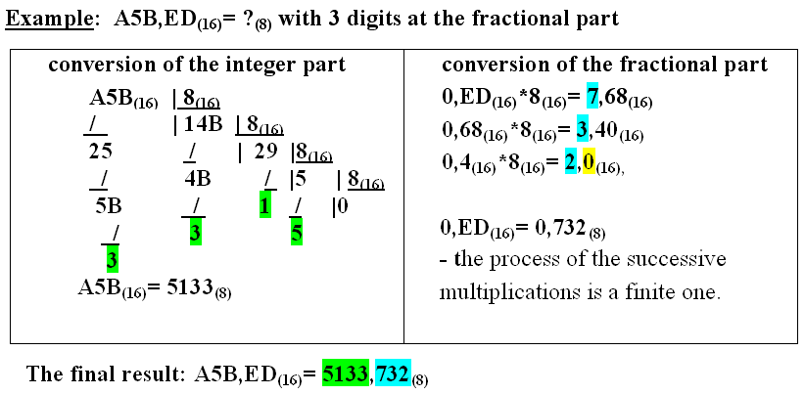
The method of successive divisions and multiplications

Slide 21

3.The method that uses an intermediate base
b - source base, g – intermediate base, h - destination base
a) usually g = 10 – calculation in base 10
conversion from base b into base 10 – using the substitution method,
conversion from base 10 into base h – using the method of successive divisions/multiplications
b) if b and h are powers of 2, then g = 2 and rapid conversions are applied
c) if b = 10 and h = 2 then for efficiency we use g = 8 or g = 16
conversion from base 10 into base g - the method of successive
divisions/multiplications is applied
conversion from base g into base 2 – rapid conversions are applied

